Slide 1

Chapter 1: Catalysts for Change

Slide 2
Organization of Chapter
Finalized Addendum
Introduction
Milestones in computing
Milestones in networking
Milestones in information storage and retrieval

Slide 3
Information Age
Modern era
Emergence of many new technologies
Unprecedented access to information
Catalysts
Low-cost computers
High-speed communication networks

Slide 4
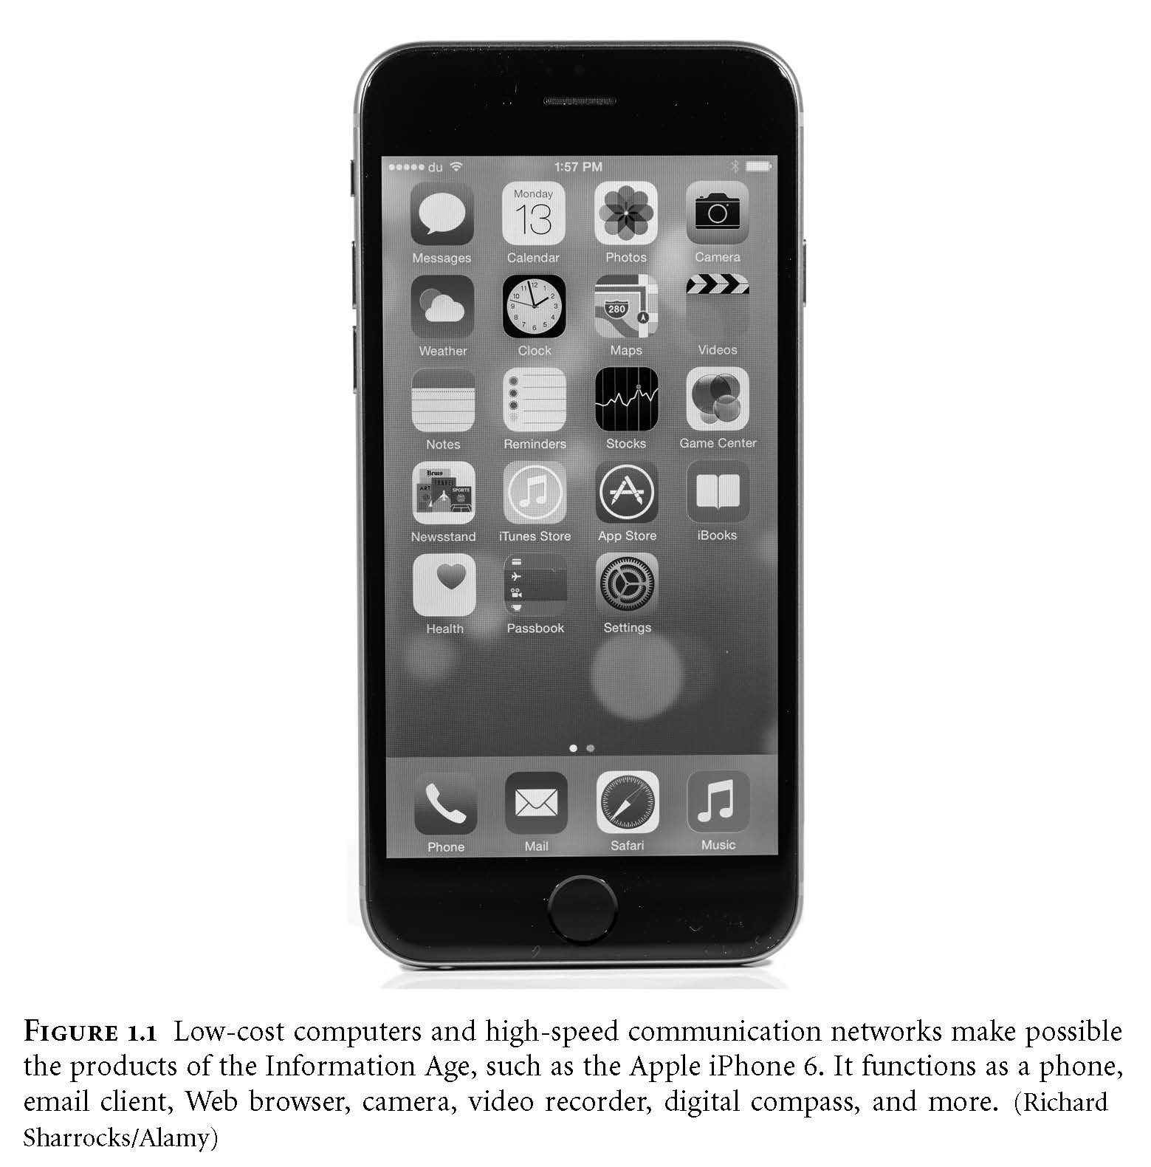
Apple iPhone 6 Emblematic Product of the Information Age
<Insert image from Figure 1.1 here: Apple iPhone 6>

Slide 5
Technology and Values
Dynamic between people, technology
People invent, adopt technology
Technology changes society
Using technology can change people
Experiences cause physical changes in brains (e.g., London taxi drivers)
Experiences with technology can have psychological effects, too (e.g., dependency on cell phones)
Technologies solve problems, but may create new problems
Automobile
Refrigerator
Low-cost international communication

Slide 6
Amish Selectively Adopt New Technologies
AP Photos/The Indianapolis Star and News, Mike Fender

Slide 7
Information Technology
Definition:
Devices used in creation, storage, manipulation, dissemination of data, sound, and/or images
Examples
Tablets, smartphones, laptop computers
People making greater use of IT
Costs keep falling
Capabilities keep rising

Slide 8
1.2 Milestones in Computing

Slide 9
Early Mechanical Calculators
Calculators of Pascal and Leibniz (17th century)
Worked with whole numbers
Unreliable
Arithmometer of de Colmar (19th century)
Took advantage of advances in machine tools
Adopted by insurance companies
Printing calculator of Scheutzes (19th century)
Used method of differences pioneered by Babbage
Adopted by Dudley Observatory in New York
Completed astronomical calculations

Slide 10
Social Change → Market for Calculators
Gilded Age (late 19th century America)
Rapid industrialization
Economic expansion
Concentration of corporate power
New, larger corporations
Multiple layers of management
Multiple locations
Needed up-to-date, comprehensive, reliable, and affordable information

Slide 11
Calculator Adoptions → Social Change
Fierce market
Continuous improvements in size, speed, ease of use
Sales increased rapidly
“Deskilling” and feminization of bookkeeping
People of average ability quite productive
Calculators 6× faster than adding by hand
Wages dropped
Women replaced men

Slide 12
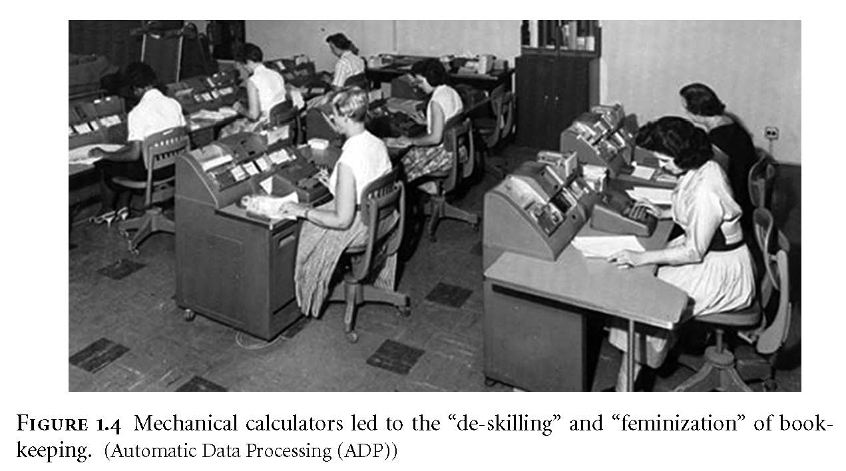
Feminization of Bookkeeping
<Insert image from Figure 1.4 here>

Slide 13
IT Issues (1/3)
Credit cards
Convenience over cash and checks
Increases possibility of identity theft
Who owns information about transactions?
Loan applications
Based on credit history, not personal interview
Lower interest rates, but less flexibility
Telecommuting
Saves time, allows more flexible work hours
Do teleworkers get overlooked for promotions?

Slide 14
IBM and the Holocaust
Hitler came to power in Germany in 1933
IBM CEO Watson ignored anti-Semitic violence, creation of concentration camps
IBM expanded German subsidiary and sought contracts with German government
Nazis used IBM machines to conduct censuses, generate lists of Jews
Lists facilitated seizure of assets and deportation to camps

Slide 15
Precursors of Commercial Computers
Atanasoff-Berry Computer: vacuum tubes
ENIAC: externally programmed with wires
EDVAC: program stored in memory
Small-Scale Experimental Machine: CRT memory

Slide 16
Programming the ENIAC
© CORBIS

Slide 17
First Commercial Computers
Remington-Rand
Completed UNIVAC in 1951
Delivered to U.S. Bureau of the Census
Predicted winner of 1952 Presidential election
IBM
Larger base of customers
Far superior sales and marketing organization
Greater investment in research and development
Dominated mainframe market by mid-1960s

Slide 18
Time-Sharing Systems and BASIC
Time-Sharing Systems
Divide computer time among multiple users
Users connect to computer via terminals
Cost of ownership spread among more people
Gave many more people access to computers
BASIC
Developed at Dartmouth College
Simple, easy-to-learn programming language
Popular language for teaching programming

Slide 19
Transistor
Replacement for vacuum tube
Invented at Bell Labs (1948)
Semiconductor
Faster
Cheaper
More reliable
More energy efficient

Slide 20
Fairchild Semiconductor Founders
Wayne Miller/Magnum Photos, Inc.

Slide 21
Antecedents to the Personal Computer
Whole Earth Catalog
“Sort of like Google in paperback form” (Steve Jobs)
Stewart Brand saw “technology as a tool for individual and collective transformation” (Fred Turner)
People’s Computer Company
Educated people on how to use computers
People gathered around time-share computers
Culture promoted free exchange of software
Homebrew Computer Club
Meeting place for hobbyists
Steve Wozniak created system that became Apple I

Slide 22
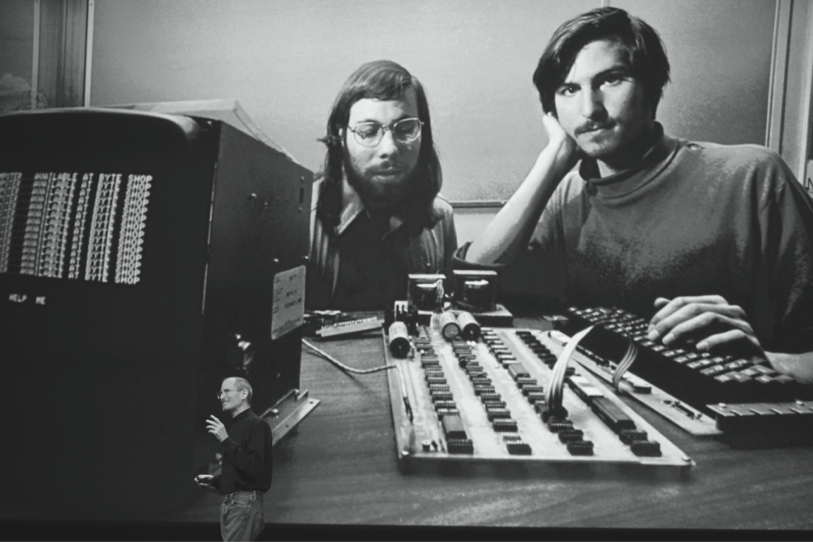
Steve Wozniak and Steve Jobs with Apple I Personal Computer
© Kimberly White/Corbis

Slide 23
Personal Computer
Altair 8800
Gates and Allen created BASIC interpreter
Interpreter pirated at Homebrew Computer Club meeting
Personal computers became popular
Apple Computer: Apple II
Tandy Corporation: TRS 80
Businesses drawn to personal computers
Computer spreadsheet program: VisiCalc
IBM launches IBM PC

Slide 24
1.3 Milestones in Networking

Slide 25
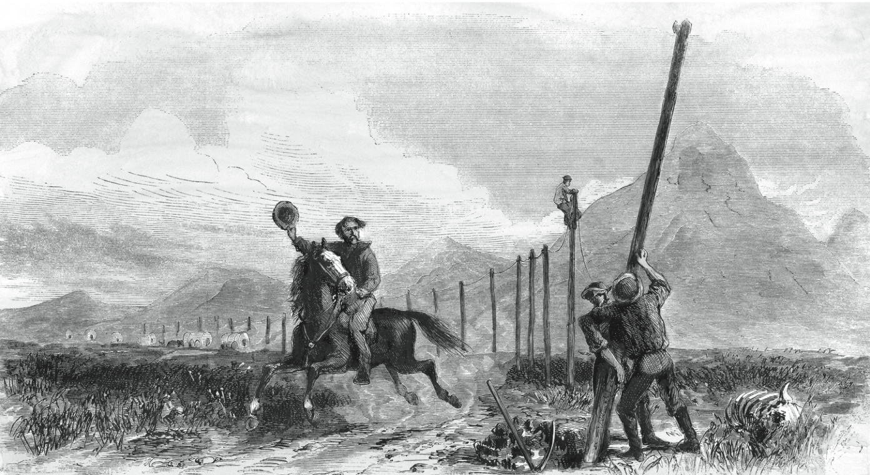
Transcontinental Telegraph: Pony Express Riders Lose Jobs
© North Wind Picture Archives / Alamy

Slide 26
Telephone
Alexander Graham Bell
Constructed harmonic telegraph
Leveraged concept into first telephone
Social impact of telephone
Blurred public life / private life boundary
Eroded traditional social hierarchies
Reduced privacy
Enabled first “online” communities

Slide 27
Radio
Pioneers
Hertz generated electromagnetic waves
Marconi invented radio
First used in business
Wireless telegraph
Transmit voices
Entertainment uses
Suggested by Sarnoff
Important entertainment medium by 1930s

Slide 28
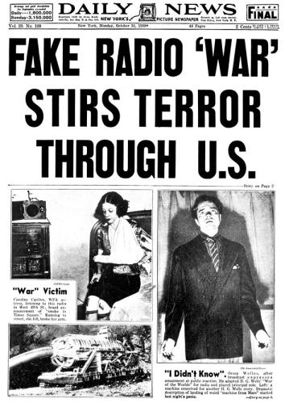
War of the Worlds
Radio allowed the generation of mass feeling, as demonstrated by the mass panic caused by H.G. Welles’s War of the Worlds in 1938.

Slide 29
Television
Became popular in 1950s
Price fell dramatically
Number of stations increased
Social effects
Worldwide audiences
Networks strive to be first to deliver news
Impact of incorrect information; e.g., 2000 presidential election

Slide 30
Hundreds of Millions Watch Moon Landing in 1969
Courtesy of NASA

Slide 31
ARPANET
DoD created ARPA in late 1950s
Licklider conceived of “Galactic Network”
Decentralized design to improve survivability
Packet-switching replaced circuit switching

Slide 32
Internet
Kahn conceived of open architecture networking
Cerf and Kahn designed TCP/IP protocol
Internet: network of networks communicating using TCP/IP

Slide 33
IT Issues (2/3)
Improved global communication network
Allows companies to sell to entire world
Allows companies to move jobs out of U.S.
Should IT consumers be concerned about working conditions in factories in developing countries?
World Wide Web
A conduit for democratic ideas?
Another tool for totalitarian governments?

Slide 34
Wireless Networks
Cell phones
Appeared in 1973, weighed 2 ½ pounds
Now weigh a few ounces and also support texting and broadband Internet access
Public access wireless local area networks
Proposed in 1993
Hotspot: wireless Internet access point
Wi-Fi most common hotspot technology

Slide 35
1.4 Milestones in Information Storage and Retrieval

Slide 36
Greek Alphabet
True alphabet: letters for both consonant and vowel sounds
750 BC: Greeks developed first true alphabet with 24 characters
Simple, efficient way of transforming spoken words into written form
Oral culture transitioned to written culture

Slide 37
Gutenberg’s Printing Press
Based on movable metal type
Church principal customer of early publishers
Powerful mass communication tool
Printing press’s impact on Reformation
More than 300,000 copies of Luther’s publications
Protestants out-published Catholics by 10-to-1 in the middle 16th century

Slide 38
Newspapers
Newspapers: Stimulated free expression
Governments responded
Licensing
Censorship
Impact on American Revolution
Newspapers helped unify colonies
Swayed public opinion toward independence

Slide 39
Hypertext
Vannevar Bush envisioned Memex
Ted Nelson
Coined word hypertext
Proposed creation of Xanadu
Douglas Engelbart
Directed construction of NLS (oNLine System)
Demonstrated windows, email, mouse, videoconferencing

Slide 40
IT Issues (3/3)
Pirating copyrighted content
Digitization → perfect copies of content
Internet → fast, inexpensive distribution
Result: illegal downloading
1st episode of season 5 of Game of Thrones illegally downloaded more than 1 million times in U.S.
Three-quarters of Chinese users of Microsoft products do not have properly licensed software

Slide 41
Graphical User Interface
Xerox PARC (Palo Alto Research Center)
Alan Kay saw Doug Engelbart demo in 1968
Alto personal computer (early 1970s)
Bit-mapped display, keyboard, and mouse
Apple Computer
Steve Jobs visited Xerox PARC in 1979
Macintosh (1984)
Bit-mapped display, keyboard, and mouse
Microsoft Windows (1990)
Released in May 1990
Quickly became dominant graphical user interface

Slide 42
Summary
Revolutionary discoveries are rare; change is usually incremental
Information technology has long history
Social conditions give rise to new technologies
Adoption of technologies can change society
Rate of technological change accelerating

